Slide 1
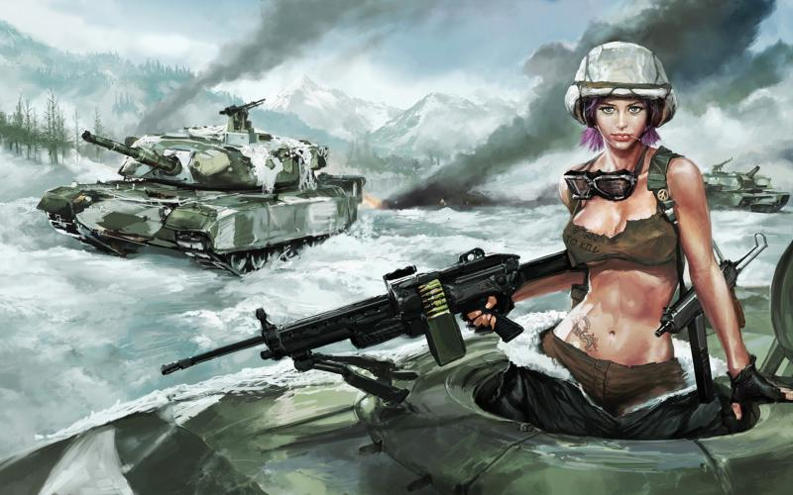
CSC-413 Tank Game Presentation
Team-16
Aye S. Win
Shan Kwan Cho

Slide 2


Game Rules
Game Description: One player (Blue Tank) can control the keyboard with the keys :
Back arrow = backward movement
Forward arrow = Forward movement
Up arrow = upward movement
Down arrow = downward movement
Space = shoot the bullet
The opponent (Red Tank) can control the keyboard with the keys :
A = backward movement
D = Forward movement
W = upward movement
S = downward movement
Enter = shoot the bullet

Slide 3
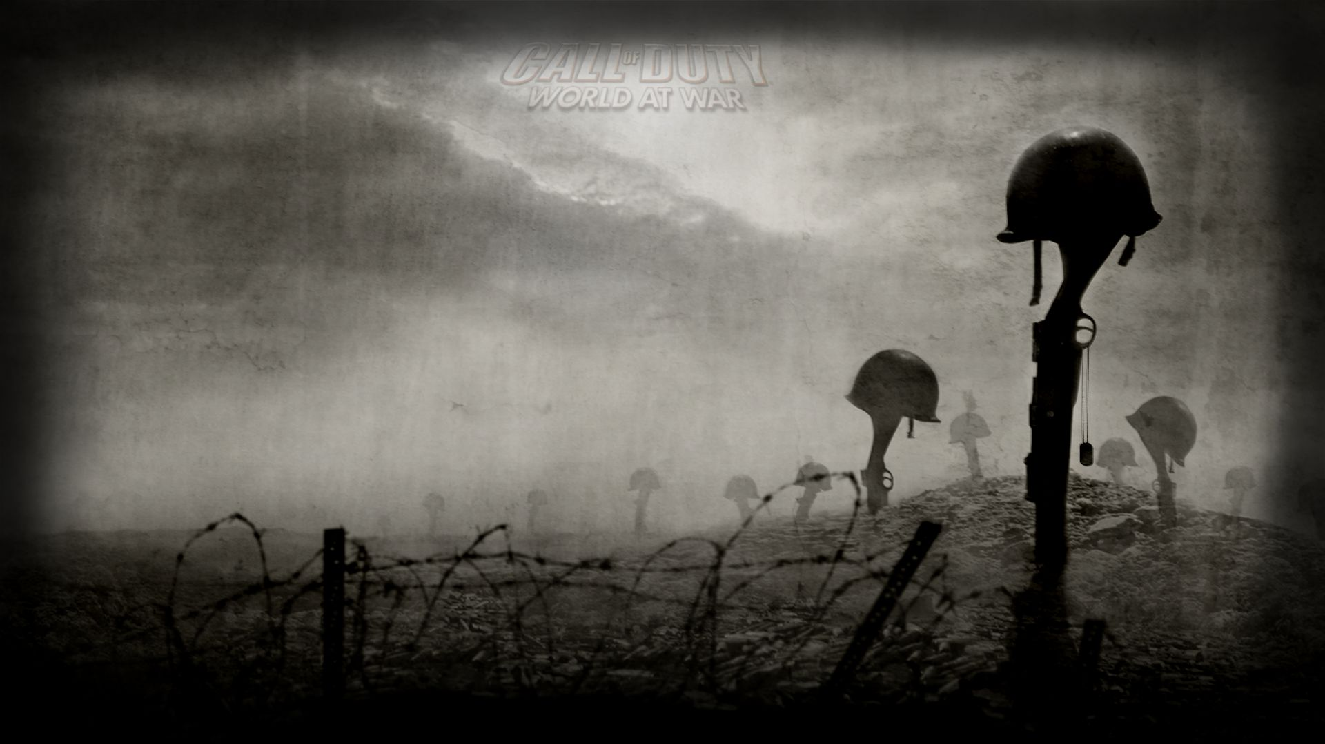
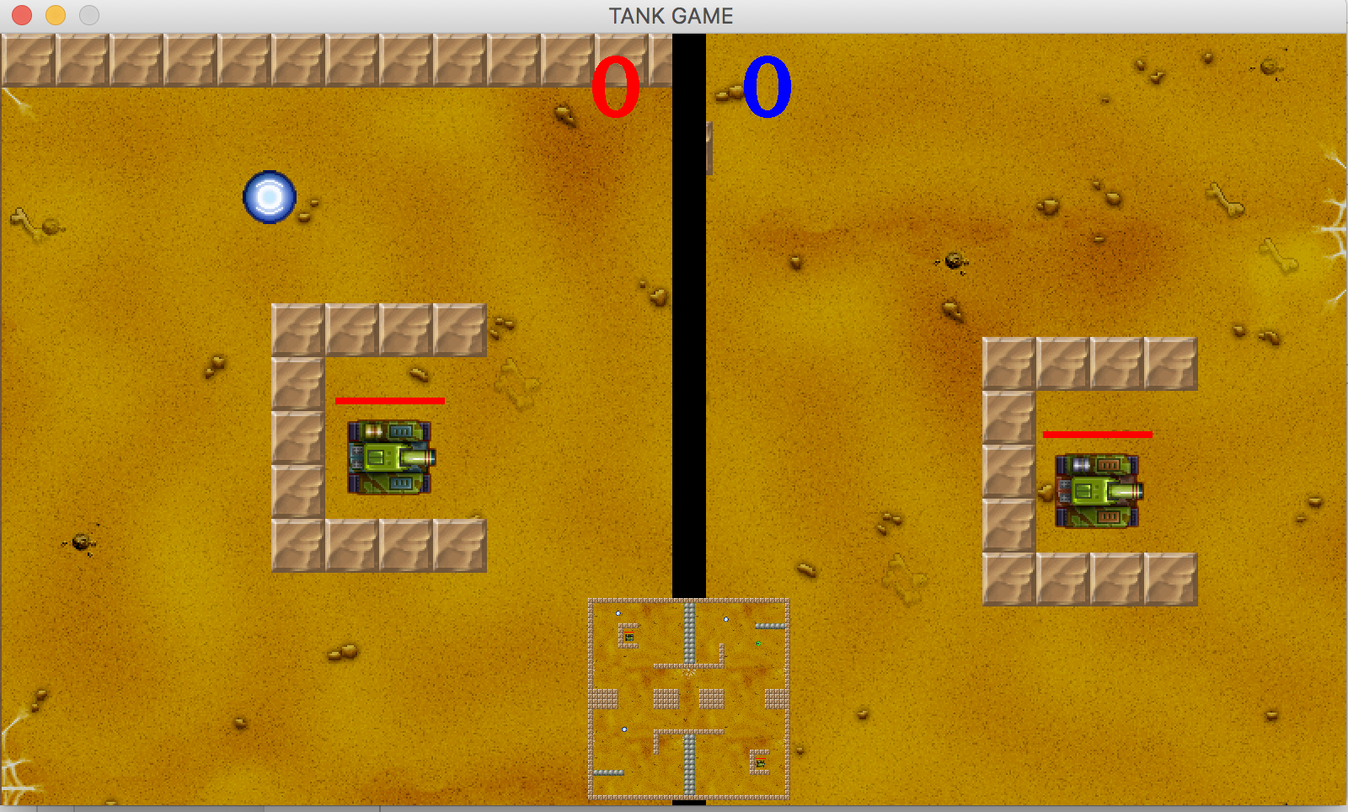
Demo Tank Game

Slide 4
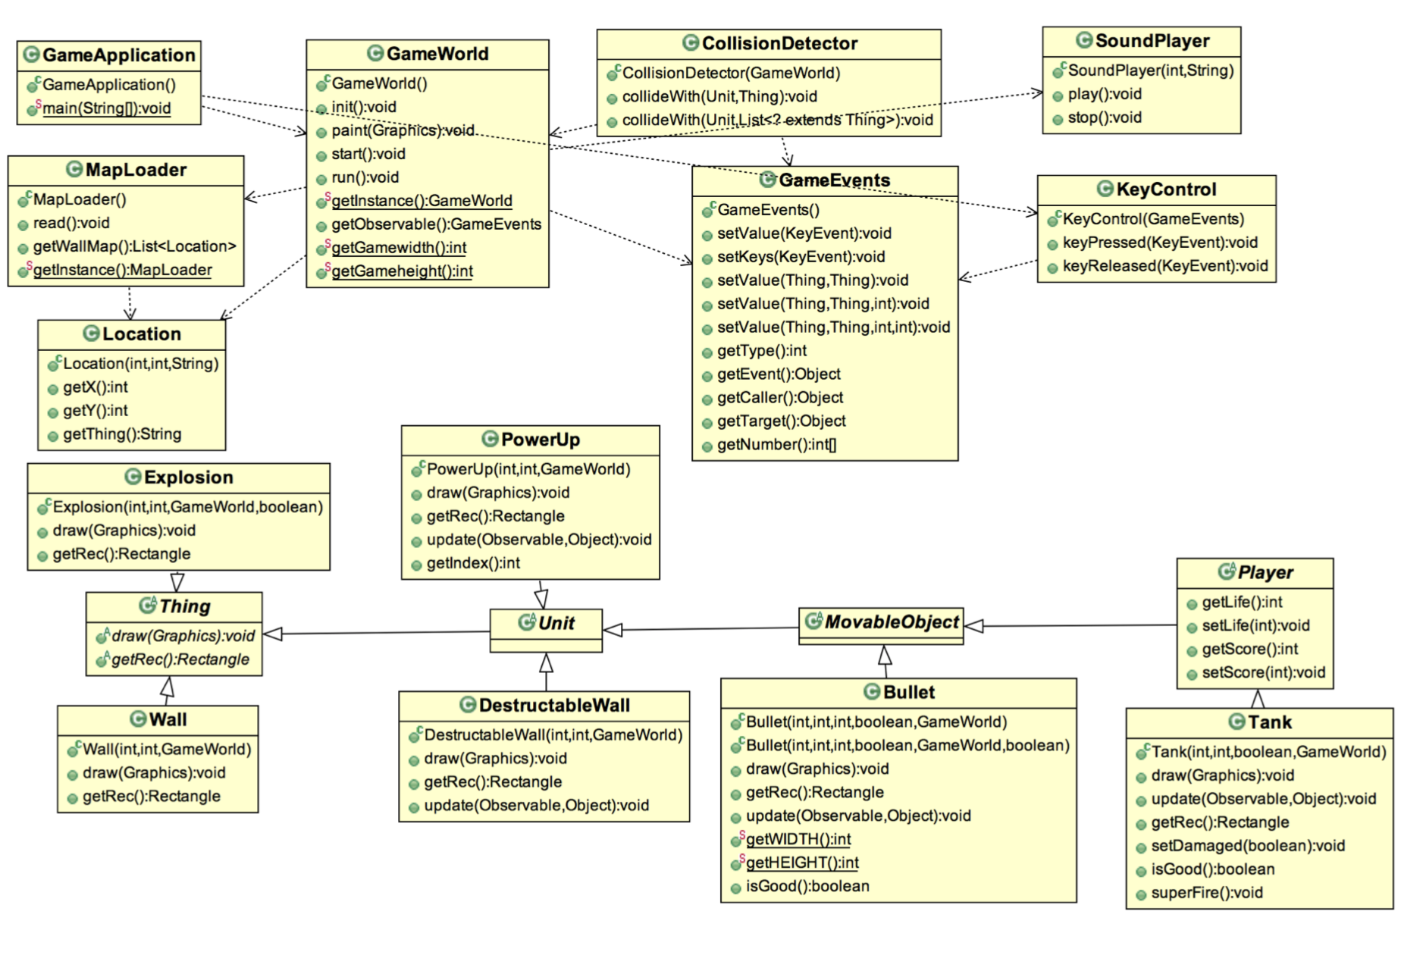


Slide 5

Class Descriptions
GameApplication
Main method
Swing.JFrame & draw methods
GameWorld
Extends Jpanel/ interfaces Runnable
Use Threads
Readable image Image.IO from resources by using try-catch
Most methods ( draw, paint of width, height wall/wallList)
GameEvents
Extend Observer
Set/Get value, keys, target, numbers
Tank
Properties of tank : Jpanel, draw,update,stay, move, fire, damaged
Check boolean whether shield is false (damage) else draw shield image(protected)
Notes:
Shield
Try catch strategies
Check with boolean shield false -> damage / else draw shield Image

Slide 6
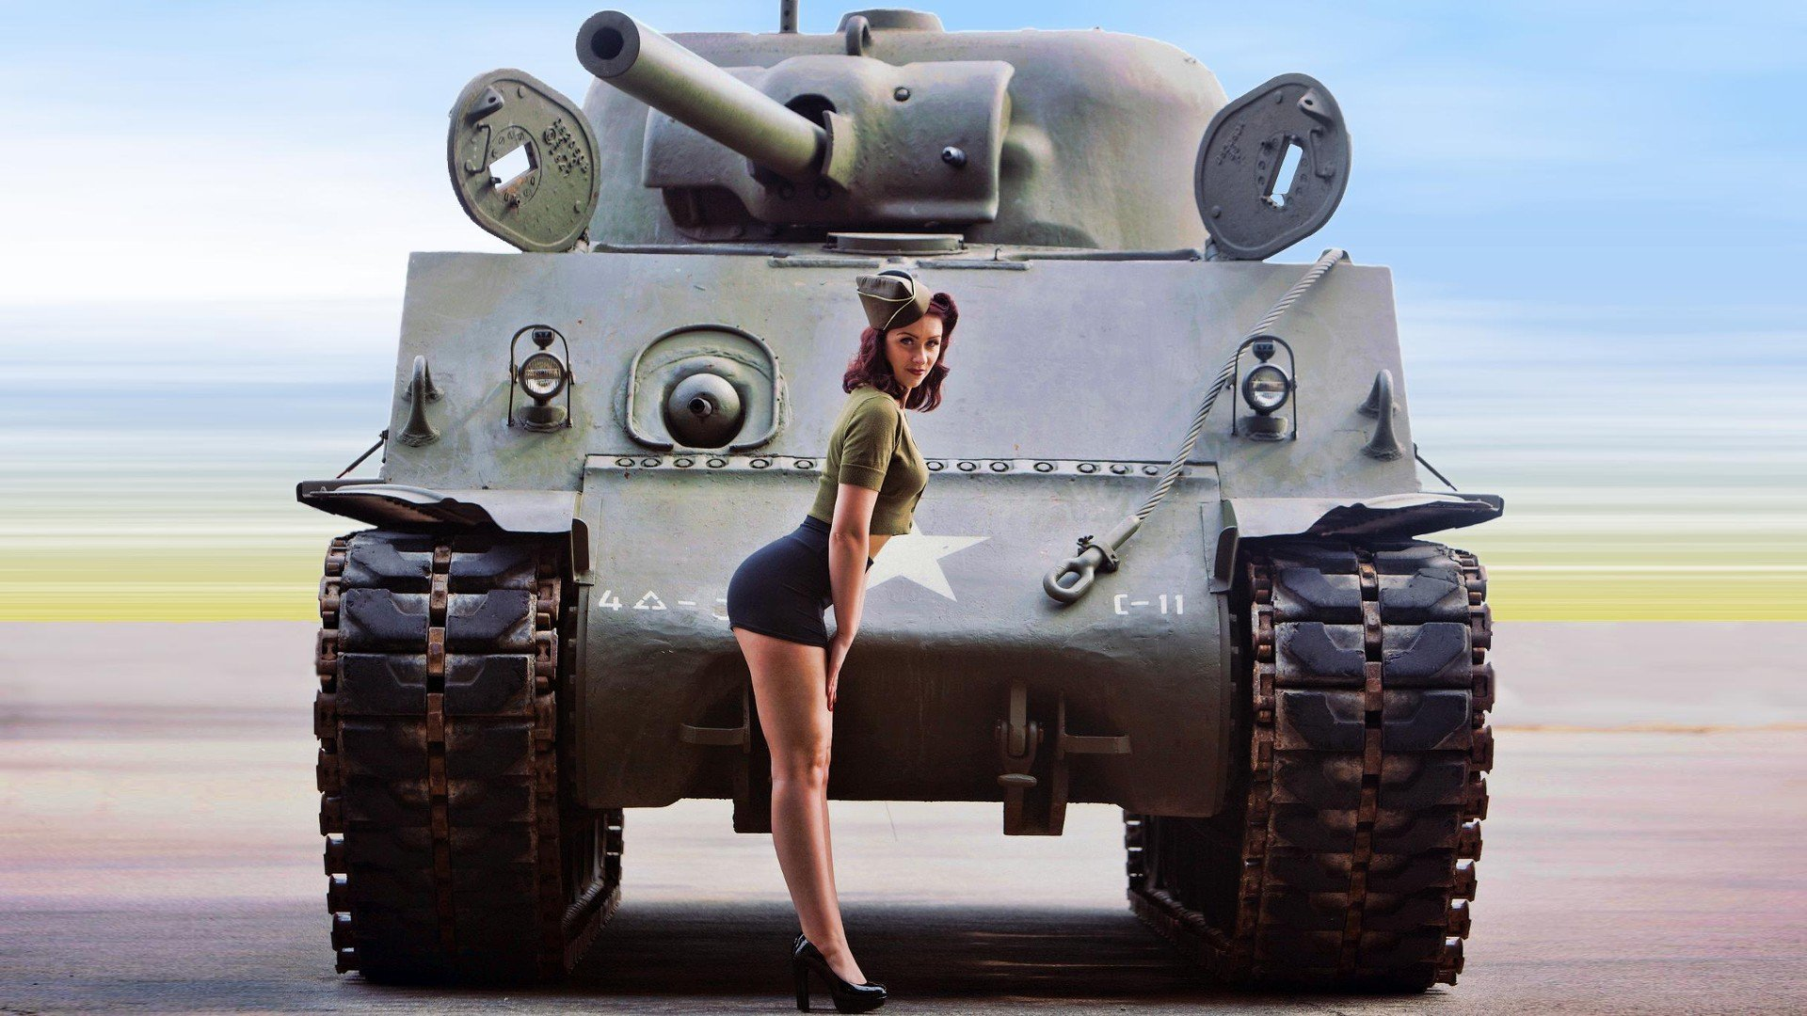
KeyControl
Extend KeyAdpater/Listener
Use keyPressed/keyReleased
MapLoader
Read method using try-catch strategies
ArrayList to split screen ( Hard Part)
Moveable
Get/set Speed & direction
Unit (abstract)
Boolean check/set damage of players >
Thing (abstract)
Draw Rectangle get/set of players fit into paint graphic
Player (abstract)
Get/set Life and scores

Slide 7

SoundPlayer
Java library : sampled_audio_input_stream, audio_system
Thread with play and pause(stop)
Bullet
Extends MoveableObject /set SPEED
Move along with the tank:draw, move, getRec*, update post of players
CollisionDetector
Caller Target functions to other classes Unit, Thing and Tank
One mistakes <We use iterator loop, got ConcurrentModificationException Error>
Explosion
extends Thing class/ try-catch strategies
After explosion/ restart (re-draw new rectangle for tank , set time )

Slide 8
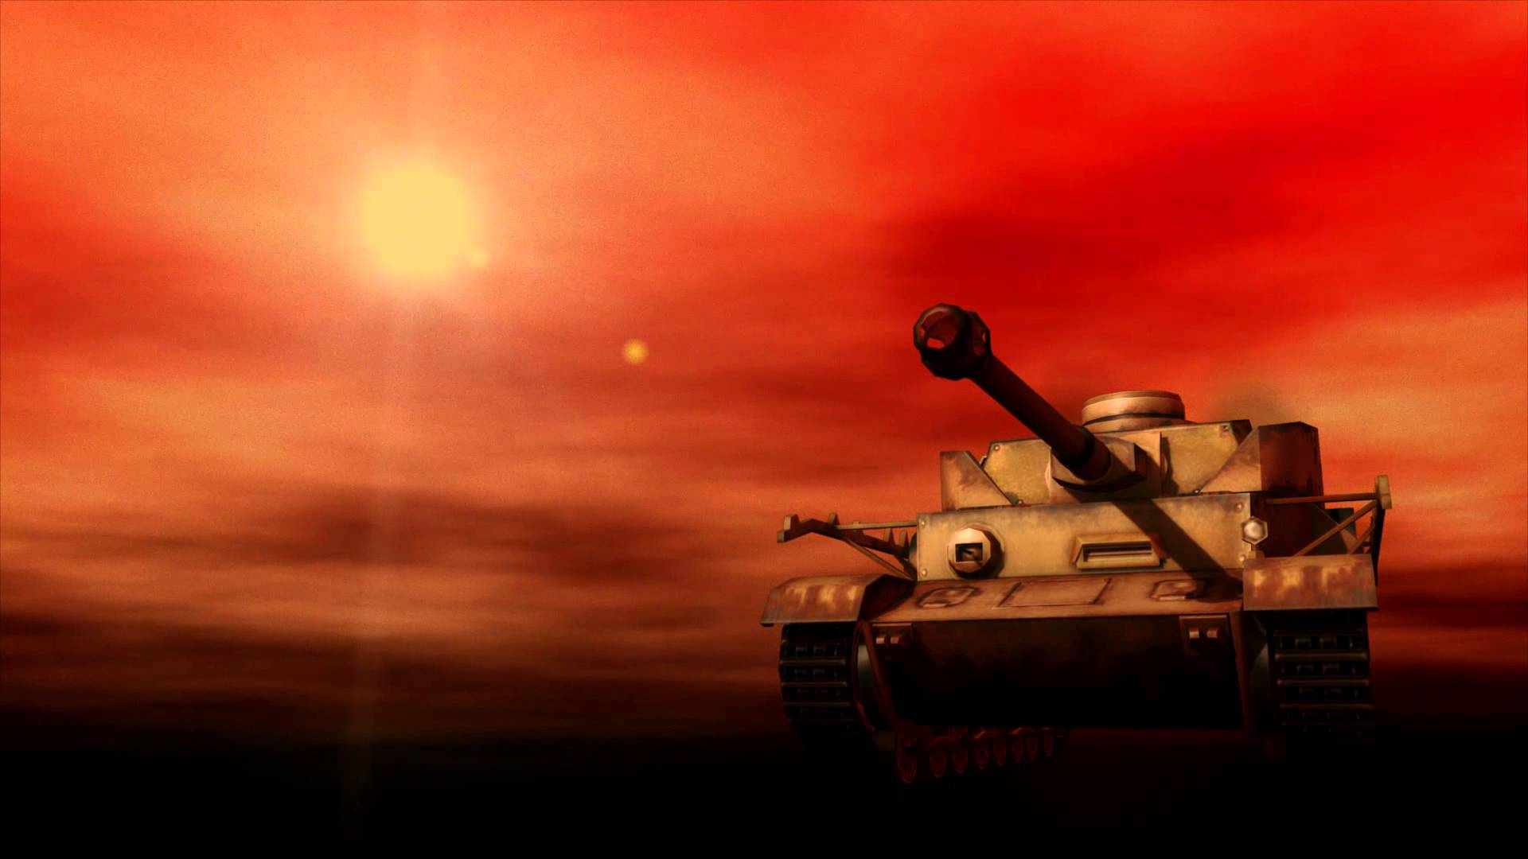

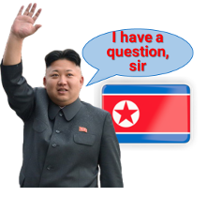
Contact Information
Aye S. Win awin@mail.sfsu.edu
Shan Kwan Cho scho4@mail.sfsu.edu

Slide 9

